Slide 1
A NATO KEKK helye és szerepe a globális változások kezelésében
Budapest, 06. September 2011
Col Dr. Thomas Harbaum, MSc.
Deputy Director and Chief of Staff

Slide 2


Slide 3


Slide 4
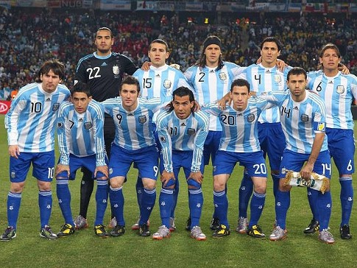

Slide 5


Slide 6
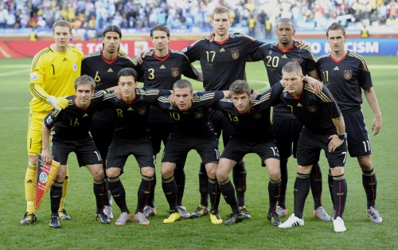

Slide 7


Slide 8
NATO Strategic Concept
Cold War period
DC 6/1
The Strategic Concept for the
Defense of the North Atlantic Area
1949
MC 3/5
The Strategic Concept for the
Defense of the North Atlantic Area
1952
MC 14/3
Overall Strategic Concept
for the Defence of the NATO Area
1968
MC 14/2
Overall Strategic Concept
for the Defence of the NATO Area
1957
Immediate post-Cold War period
Post 9/11 era
The Alliance’s
Strategic Concept
2010
The Alliance’s
Strategic Concept
1991
The Alliance’s
Strategic Concept
1999

Slide 9
Crisis Management
Engage actively before, during and after crisis;
Enhance intelligence sharing;
Expeditionary operations;
Enhance civilian-military co-operation;
Enable local forces;
Deploy civilian specialists;
Broaden and intensify political consultations.

Slide 10
„What do we want from our Military – a sort of Oxfam with guns?“
UK Labour MP 1998

Slide 11
SWOT- Analysis: Military in humanitarian aid
Strengths:
Flexibility
Protection
Communication
Intelligence
Logistics
Independence / Mobility / Infrastructure
Medical Treatment Facilities
(LSHTM & Oxford University, Qualitative study, Refugee Studies Programme Documentation Centre, 2001)

Slide 12
SWOT- Analysis: Military in humanitarian aid
Weaknesses:
Short deployments
Intercultura incompetence
Interaction with civilian players
Weapons, armourment
Costs (- benefit?)
No neutrality / impartiality
Competition with NGOs
(LSHTM & Oxford University, Qualitative study, Refugee Studies Programme Documentation Centre, 2001)

Slide 13
Military Medicine: Framework
NATO MilPolicy and strategic concept
New role of Medical in military
  from J4 to JMed: individual military patients expectations and legal rights, no „human supply problem“ any longer
  Engagement in homeland def., national emergency response, multinational deployments, humanitarian missions
Stakeholders
  Military patient
  Commanders (best medical advice)
  Public, „parents“
  Policy makers
  Other sectors (e.g. Health, Interior)
Financial framework

Slide 14
Maxim of Military Medical Support
“Every effort should be made to ensure that medical care is based on internationally accepted best medical practice.”
(MC 326-3)

Slide 15
COMEDS Main Goal
Foster Multinational
Solutions
Develop Military
Medical Capabilities
Ensure Medical Support for current and future NATO Operations
Promote Interoperability
of Medical Forces
Improve medical support
policies & concepts
Expand civil-military
medical interaction

Slide 16
Situation
(Ref.: COMEDS Plenary Autumn 2009)
  Multinationality vs. Interoperability
  Language
  Equipment
  Algorithms
  National legal frameworks
  Training

Slide 17


Slide 18








Structure

Slide 19
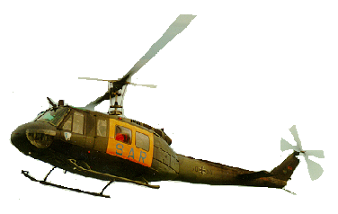
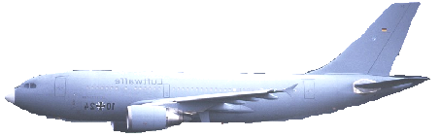
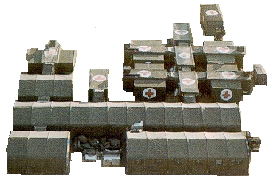
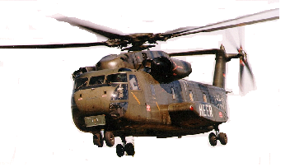
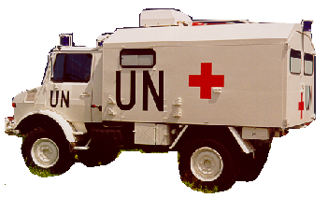

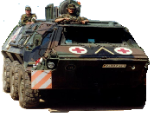
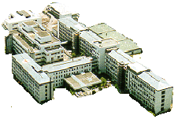
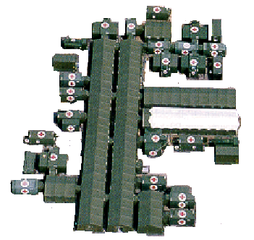
MILMED capability requirements
at home
in theater
Military hospital
civilian hospitals
field hospital
mobile surgical
hospital
rescue station
medical team
role
4
3
2 1
continued full-spectrum
treatment
and rehabilitation
immediate
clinical care
preclinical
emergency surgical
care
preclinical
emergency medical
care

Slide 20
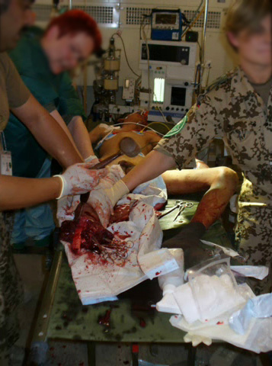

Slide 21
Infectious Diseases as Risk Factor to Military Readiness
During recent wars and military conflicts, soldiers were hospitalized because of
  Battle injuries: 5 – 25 %
  Non-battle injuries: 5 – 10 %
  Infectious diseases: 65 – 80 %
Source:
War Epidemics - An Historical Geography of Inf. Dis. in Mil. Conflict (...) 1850 – 2000;
M.R. Smallman-Raynor, A.D. Cliff, Oxford University Press 2004

Slide 22
Enable local forces
Lessons Learned from Casualty Statistics in Health Care System Development: Afghanistan 2008 – 2009 (Military Medicine, 176, 1:94, JAN2011)
A casualty is defined as a soldier unable to perform his duties from either injury or disease
Infectious diseases accounted for 10.492 (68.4%) of the 15.336 casualties (within the ANA)

Slide 23
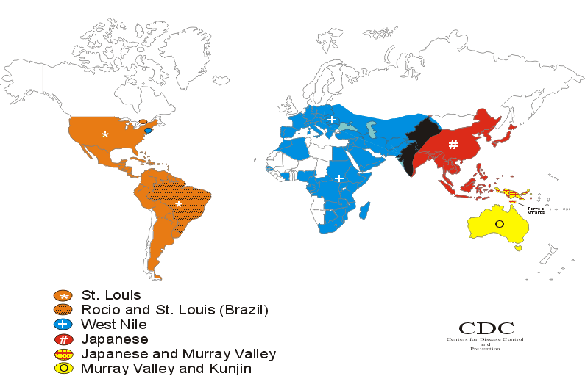
Flavi - Epidemiology

Slide 24
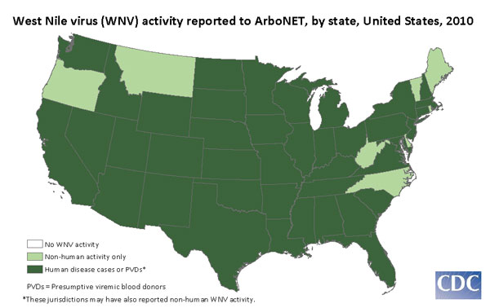
Flavi - Epidemiology

Slide 25
Flavi - Epidemiology

Slide 26
Disease Surveillance
- Definition -
  The ongoing systematic collection and analysis of data and the provision of information which leads to action being taken to prevent and control a disease (usually one of an infectious disease)
Source: US-CDC 2009

Slide 27
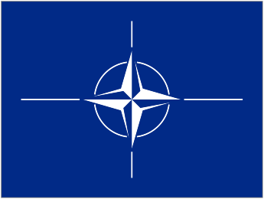
Disease Surveillance
- Principle & Situation -
Commander
Medical Advisor
Analysis
Centre
Analysis
Centre
Data
Collection
Data
Collection
Detection
Detection
31-Aug-11
Notes:
27

Slide 28
Disease Surveillance
- Concept -
Commander
Medical Advisor
NATO DHSC
Central
Analysis
Center
Analysis
Centre
Analysis
Centre
Data
Collection
Data
Collection
Detection
Detection
31-Aug-11
Notes:
28

Slide 29
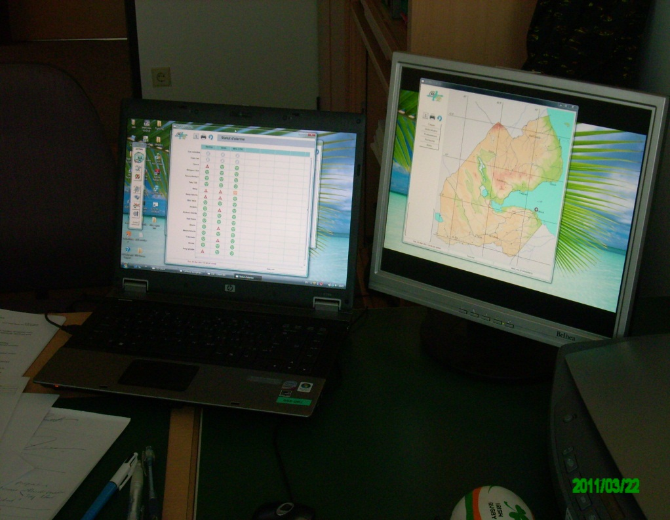
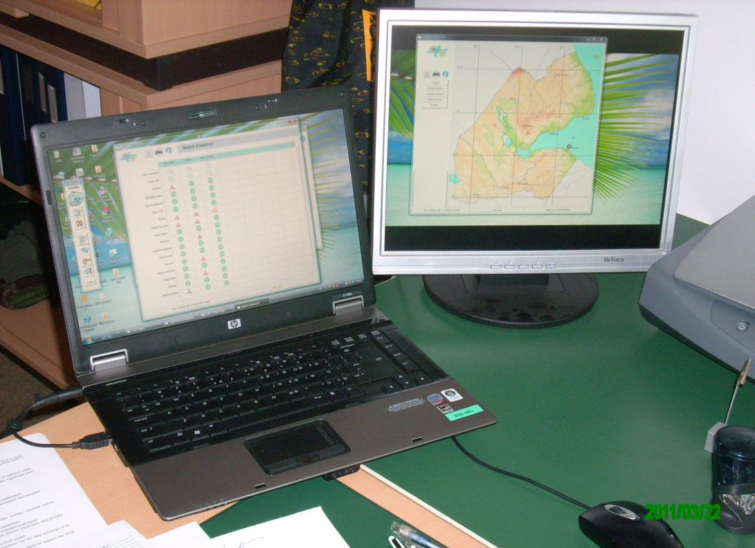
DHSC DJIBOUTI Project
Analysis and evaluation in Munich

Slide 30



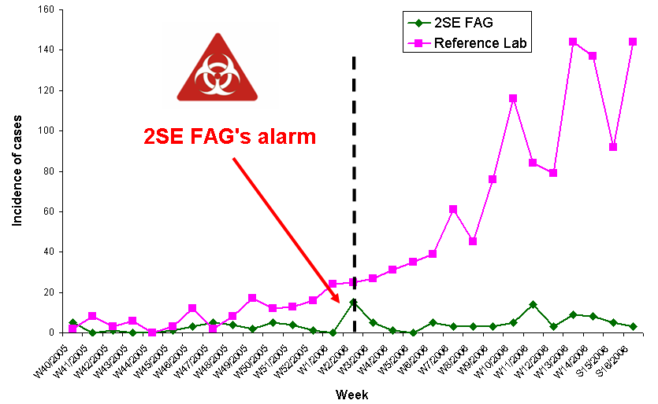


ASTER
Dengue outbreak, French Guiana, 2006
5 weeks
Reference laboratory signal
Sources :
Civilian surveillance alert
2SEFAG signal
Ref.: Col Dr. Jean-Baptiste Menard, 2011

Slide 31
Conclusion
Multinationality in Military Medicine
has to serve specific purposes,
is always a means to an end,
is a challenge and not a problem,
is indispensable for any evidence based further development of (military) medicine.

Slide 32




Impressions

Slide 33

Impressions
www.coemed.org

